Slide 1

IoT Module ESP32 with Blynk Platform
Prepared by: Muhammad Shahkhir Bin Mozamir

Slide 2
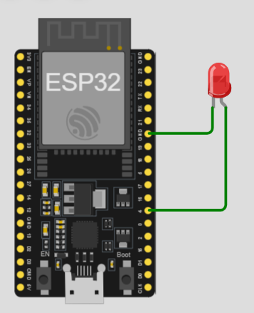
Module 1: Control LED using Blyink Platform
Set up the component on ESP32 USING https://wokwi.com/projects/new/esp32
Ground LED to Gnd ESP
Positive LED to pin 4 ESP

Slide 3
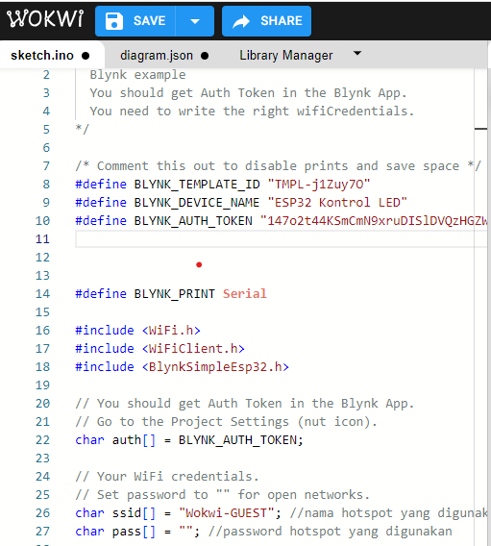
Copy and paste the code
Path: IoT Module\ESP32 FILE\wokwi_blynk

Slide 4
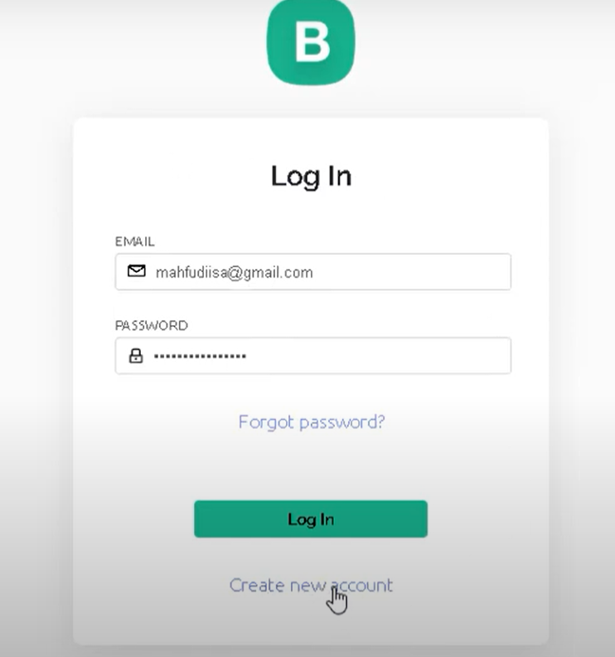
Set up the Blynk Cloud

Slide 5
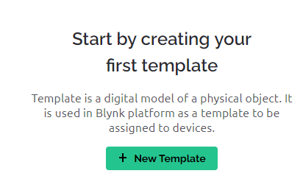
Create new template

Slide 6
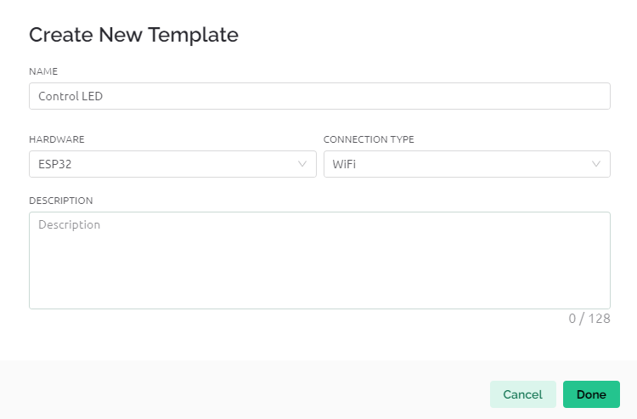
Follow as the picture

Slide 7
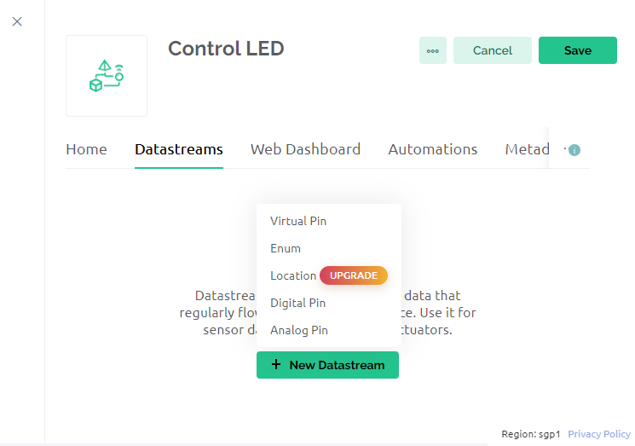
After click done, click Data Streams tab, click Virtual Pin

Slide 8
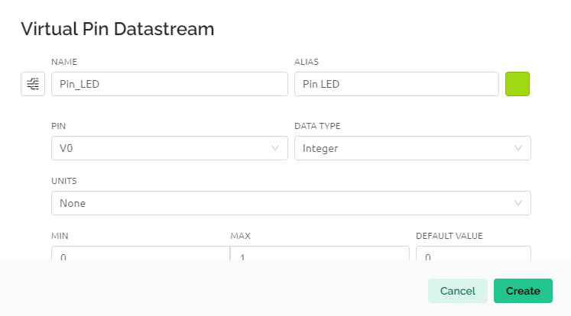
Follow the setting

Slide 9
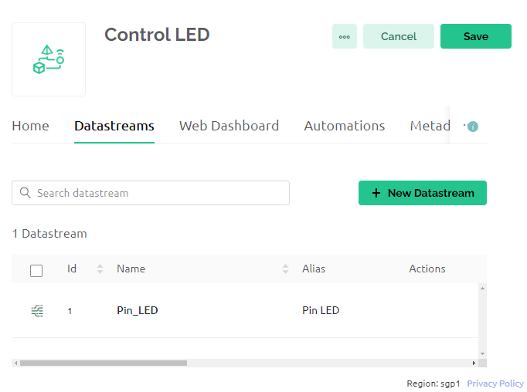
After setting will look this. Then click Web Dashboard Tab

Slide 10
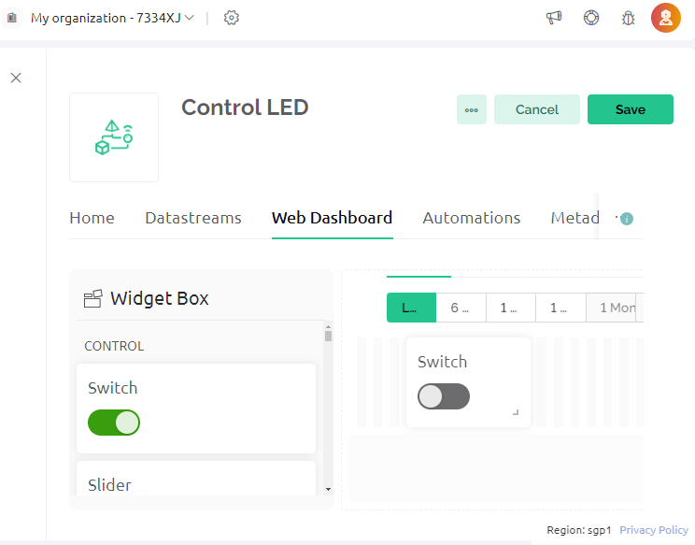
Drag the switch and click setting on the switch:

Slide 11
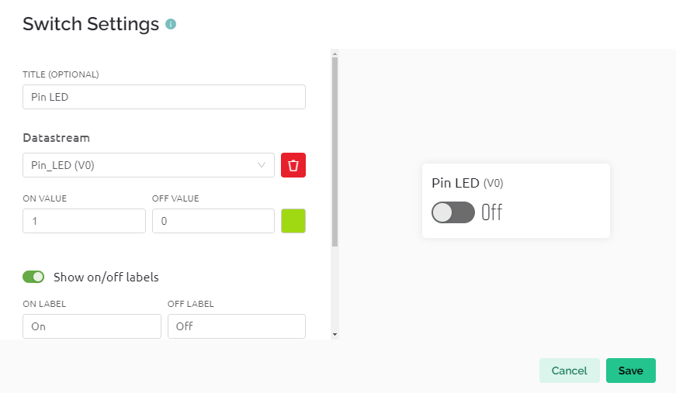
Follow the figure:

Slide 12
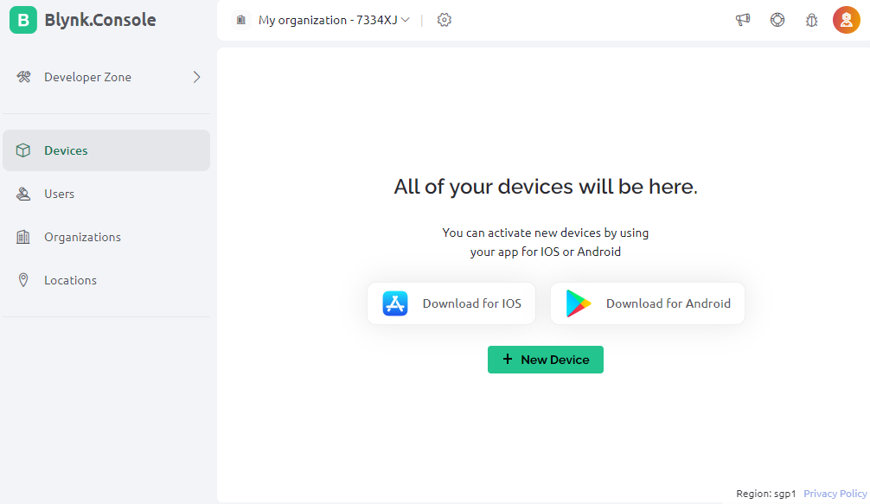
Click device and click new device

Slide 13
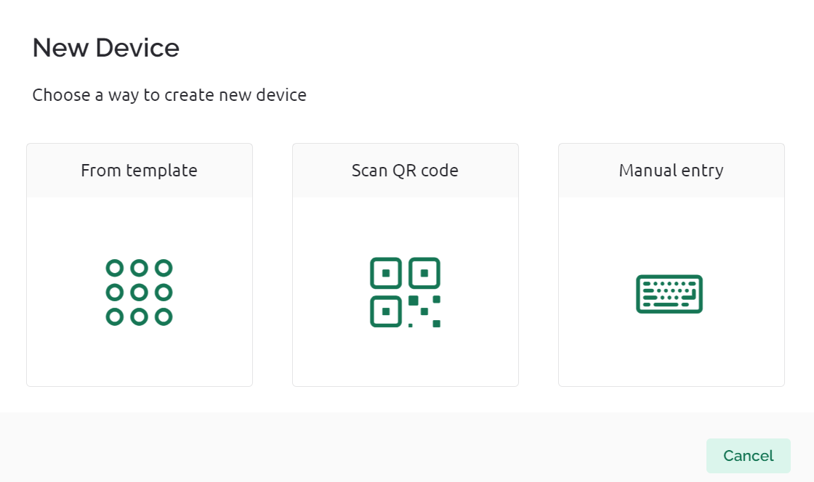
From template

Slide 14
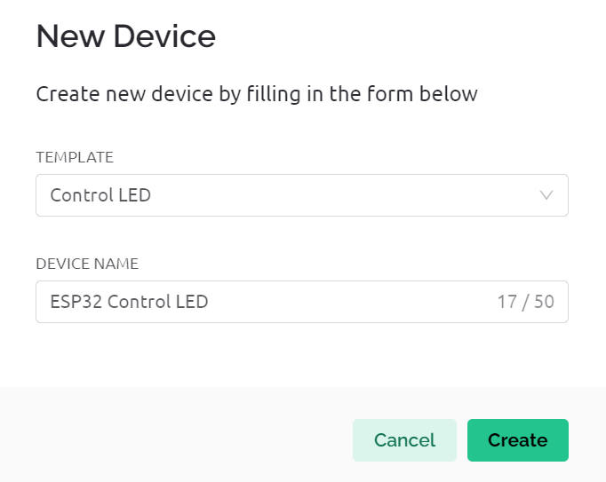
Follow Figure:

Slide 15
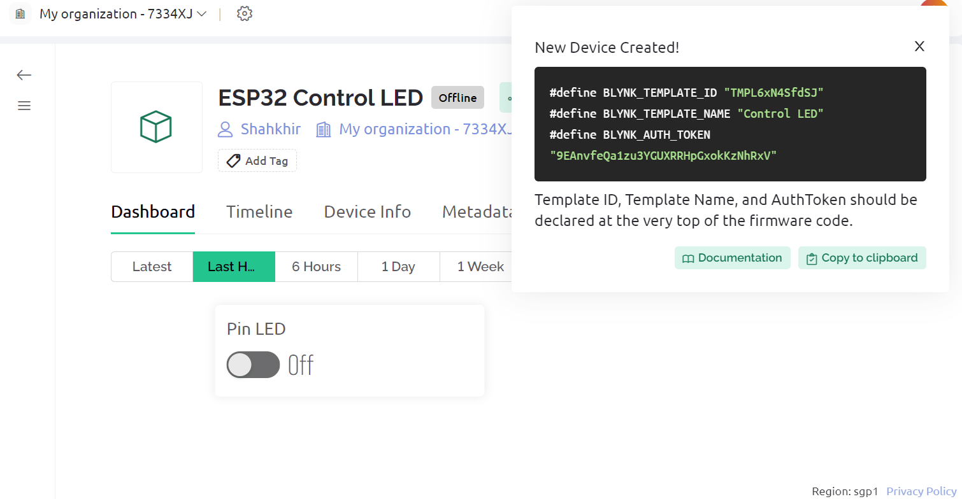
Copy the ALL THE #

Slide 16
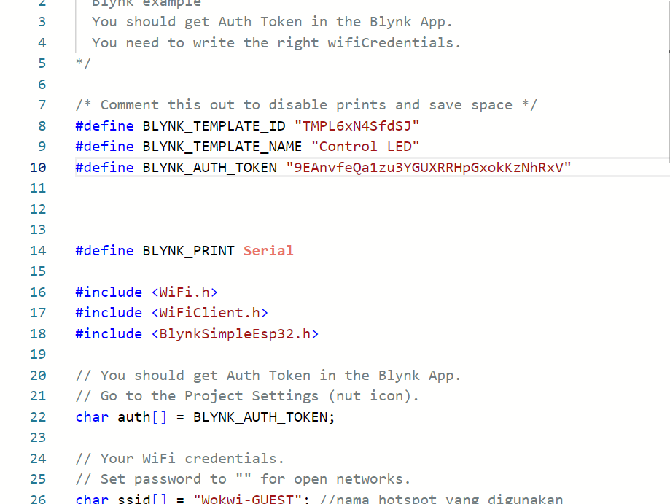
Paste at the code WOKWI

Slide 17
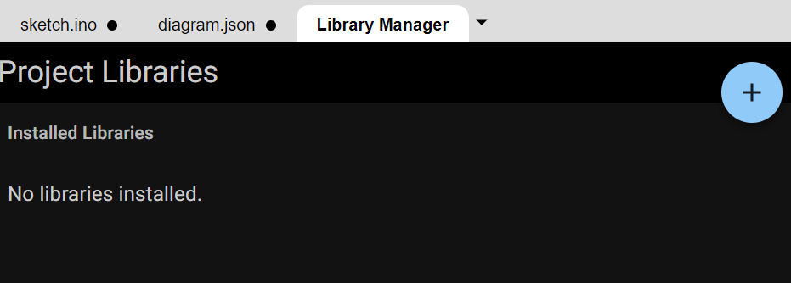
Click Library manager

Slide 18
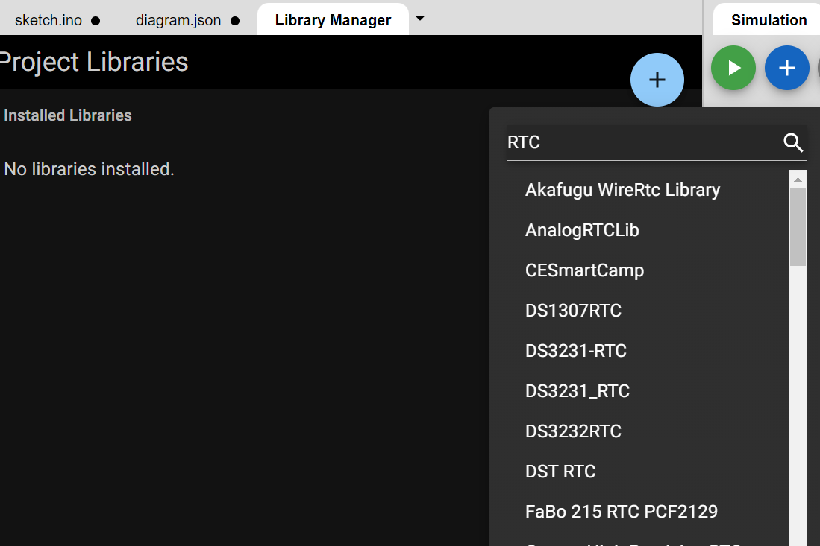
Type RTC and select DS1307RTC

Slide 19
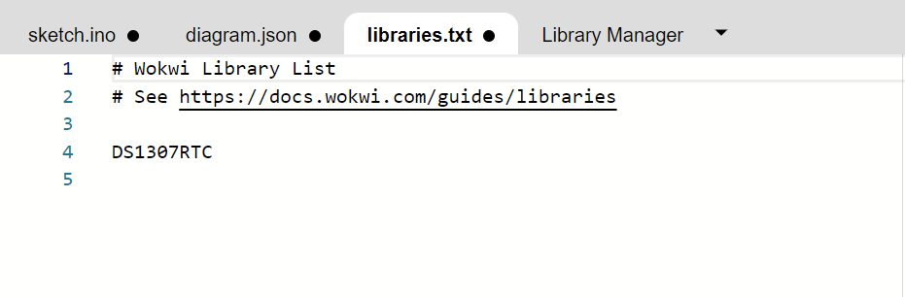
Click tab Libraries, will show the DS1307RTC, Delete it

Slide 20
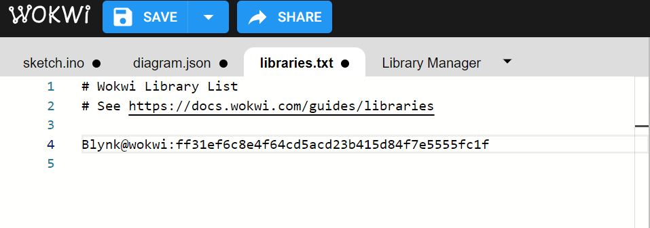
Copy the link from: \IoT Module\ESP32 FILE\library blynk di wokwi

Slide 21
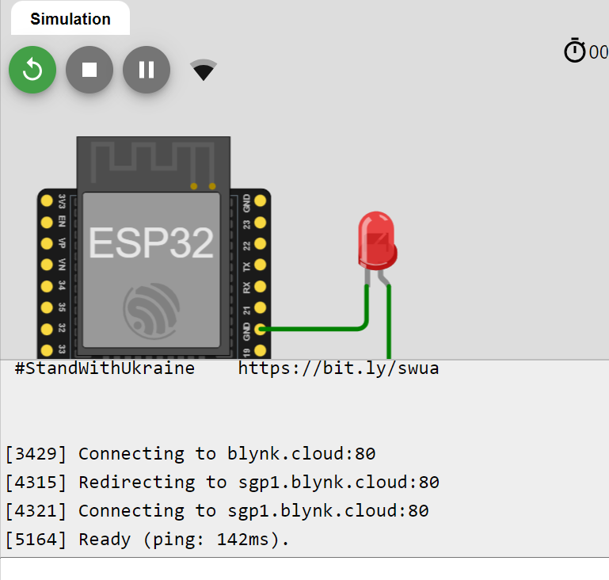
Run the simulation:

